Slide 1




NEXT GEN EMPLOYABILITY PROGRAM
Creating a future-ready workforce
Team Members
College Name
Student Name : Jovitha Melcy M
Student ID : au311121104030
Loyola ICAM College of Engineering and Technology

Slide 2

CAPSTONE PROJECT SHOWCASE
Project Title
MUSIC WEB APPLICATION USING DJANGO FRAMEWORK
Abstract | Problem Statement | Project Overview | Proposed Solution | Technology Used | Modelling & Results | Conclusion

Slide 3
Abstract
Music Studio is a web application designed to provide users with a platform for discovering, listening to, and managing their favorite music tracks. With an intuitive user interface and a vast library of songs from various genres and artists, Music Studio offers an immersive music listening experience.
Song Library: Music Studio boasts an extensive collection of songs spanning multiple genres, albums, and artists. Users can easily browse through the library to discover new tracks or search for specific songs.
Watch Later: Users can mark songs they wish to revisit later by adding them to a "watch later" list. This feature enables users to curate a list of tracks they want to explore further or listen to at a later time.
Responsive Design: The application is designed with a responsive layout, ensuring optimal viewing and interaction experiences across various devices, including desktops, tablets, and smartphones.

Slide 4
Problem Statement
The problem addressed by the Music Studio web application is the need for a user-friendly and feature-rich platform that allows users to discover, listen to, and manage their favorite music tracks seamlessly.
Key Components of the Problem Statement:
Lack of Centralized Platform: Many users struggle to find a centralized platform where they can access a wide range of music tracks from various genres and artists without having to switch between multiple applications or services.
Inefficient Music Management: Users often face difficulties in managing their music collections, such as organizing playlists, marking favorite tracks, or accessing previously played songs.
Accessibility and Compatibility: Some users may encounter issues with accessing their music libraries across different devices or platforms due to compatibility issues or lack of responsive design.
By solving these problems, Music Studio can become a valuable tool for music listeners, fostering a sense of discovery and keeping them engaged with the ever-evolving landscape of music.
Source :

Slide 5
Project Overview
The Music Studio web application is a modern and user-friendly platform designed to provide users with a seamless music streaming experience. The project aims to offer a wide range of features and functionalities to cater to the diverse needs of music enthusiasts.
User Interface (UI): The application will feature an intuitive and visually appealing user interface that allows users to navigate through the platform effortlessly.
Music Library: The core functionality of the application is to provide users with access to an extensive music library containing a diverse collection of tracks, albums, and artists across different genres.
Playlist Management: Users will be able to create, edit, and organize their playlists seamlessly within the application.
Social Features: The platform will include social features such as user profiles, social sharing, and community engagement to enhance user interaction and foster a sense of community among music enthusiasts.
Source :

Slide 6
Proposed Solution
.
Here's an expanded explanation of the proposed solution for Music Studio, diving deeper into each component:
1. Music Library and Content Management:
The application will feature an extensive music library comprising a diverse collection of songs, albums, and artists spanning various genres.
Content management tools will be implemented to organize and categorize music content efficiently.
Users will be able to search for specific songs, albums, or artists, browse curated playlists, and discover new music based on their preferences.
Source :

Slide 7
2. Personalization and Recommendations:
The platform will leverage user data and listening history to provide personalized recommendations, curated playlists, and customized radio stations.
Machine learning algorithms and recommendation engines will be employed to analyze user behavior and preferences, delivering tailored music suggestions.
Users will have the option to like, dislike, or skip songs to further refine their recommendations.
3. Playlist Management and Creation:
Users will be able to create, edit, and manage their playlists effortlessly within the application.
Advanced playlist management features, such as drag-and-drop functionality, auto-playlist generation, and collaborative playlists, will be implemented.
Users can share their playlists with friends, follow public playlists curated by others, and collaborate with other users on collaborative playlists.
Source :

Slide 8
4. User Authentication and Security:
Robust user authentication mechanisms, including username/password authentication, social media login integration, and multi-factor authentication, will be implemented to ensure secure access to user accounts.
Data encryption, secure transmission protocols (HTTPS), and other security measures will be employed to protect user data and privacy.
5. Social Features and Community Engagement:
Social features, such as user profiles, social sharing, and follower/following mechanisms, will be integrated to facilitate community engagement and interaction.
Users can connect with friends, share their favorite tracks or playlists, and discover new music based on recommendations from their network.
Community forums, discussion boards, and user-generated content (UGC) features may be included to further enhance user engagement and foster a sense of community.
Source :

Slide 9


Technology Used
Front-end
Back-end
Source :

Slide 10
Modelling & Results
Since Music Studio is still in the proposal stage, we can't showcase real-world results. However, here's a breakdown of potential modeling techniques and expected outcomes:
1. Trend Analysis Modeling:
Model Type: Time Series Analysis with Anomaly Detection
Data Input: Historical and real-time data streams from music streaming services, social media, etc.
Expected Outcome: Identify statistically significant spikes in popularity for artists, genres, or songs.
2. Personalized Recommendation Modeling:
Model Type: Hybrid Recommendation System (Collaborative Filtering & Content-Based Filtering)
Data Input: Listening history (liked songs, playlists), feedback on recommendations, artist/genre attributes.
Expected Outcome: Generate personalized recommendations for songs and artists that cater to both the user's established taste and current music trends.
Evaluation Metrics:
For Trend Analysis: Precision (accuracy of identifying rising trends), Recall (capturing significant portion of emerging trends).
For Recommendation System: Click-through rate (user engagement with recommendations), Normalized Discounted Cumulative Gain (NDCG) (ranking quality of recommendations).
Source :

Slide 11
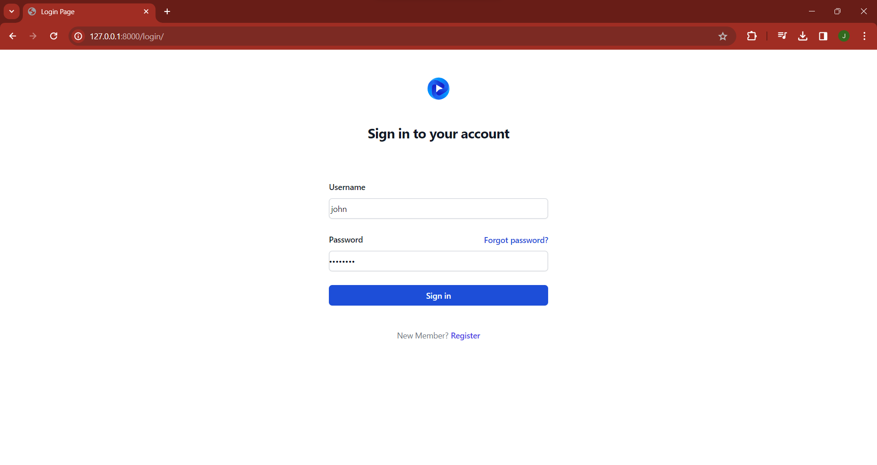
Login-Page

Slide 12
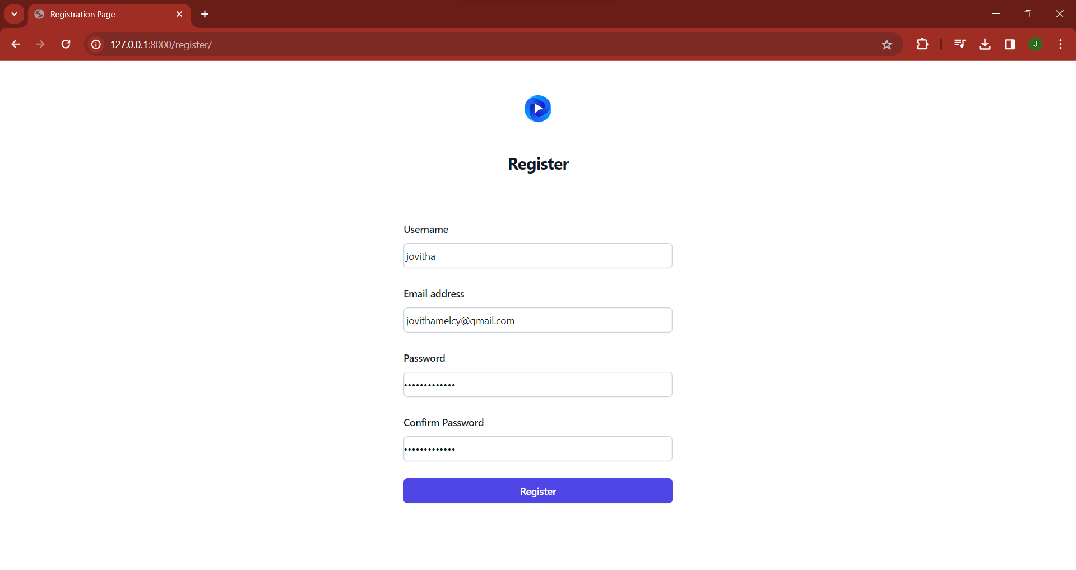
Register-Page

Slide 13
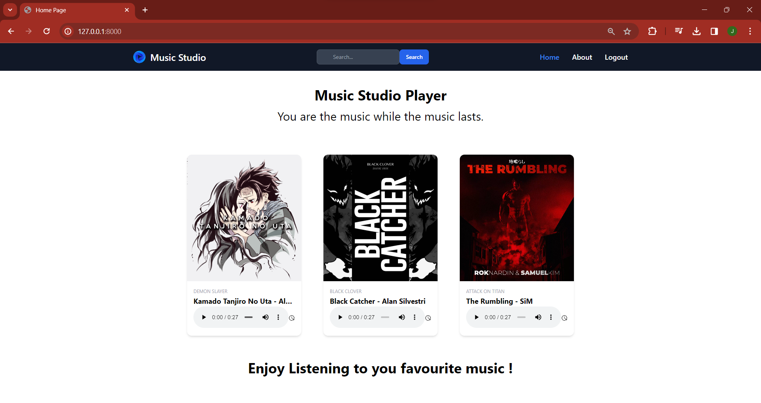
Home-Page

Slide 14
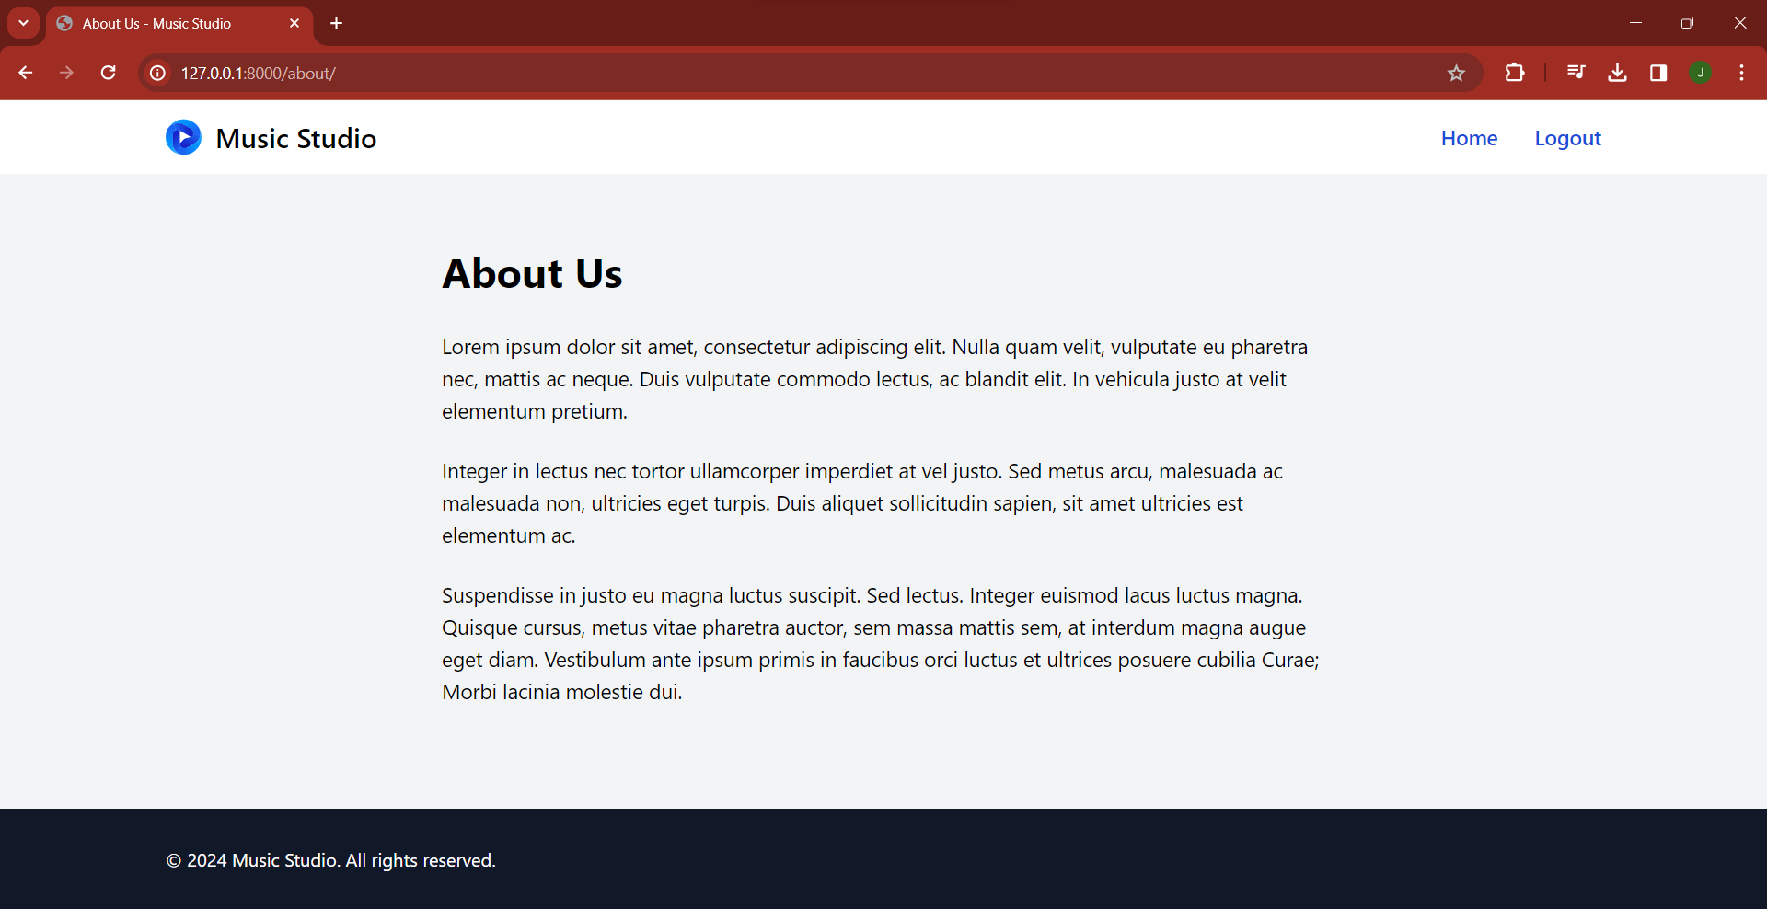
About-Us-Page

Slide 15
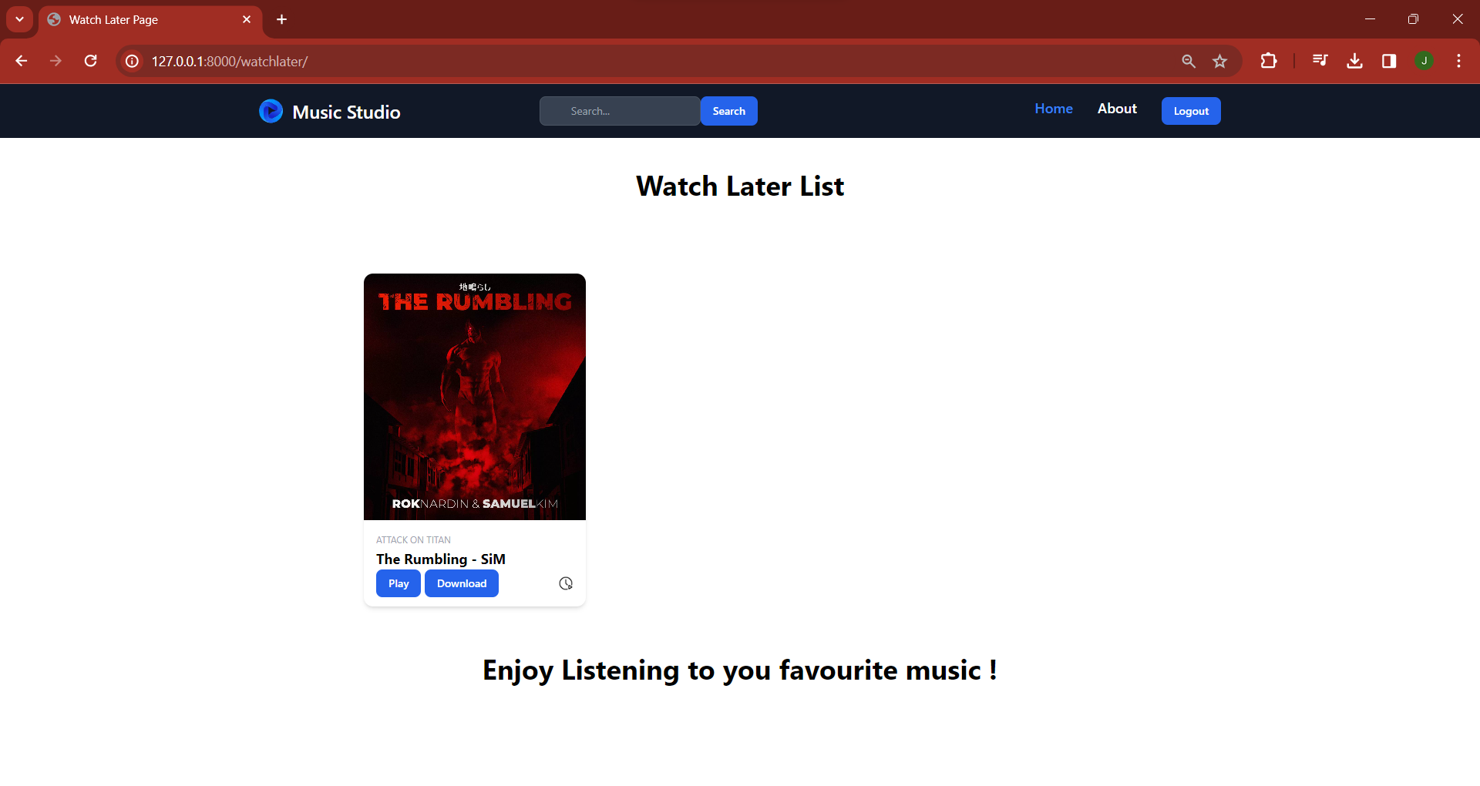
Watch-Later-Page

Slide 16
Future Enhancements:
Song Uploads:
Allow authenticated users to upload their own songs to Music Studio(consider storage limitations).
Social Features:
Integrate social features like allowing users to follow each other, share playlists, or see what songs their friends are listening to.
Song Recommendations:
Develop a recommendation system that suggests songs to users based on their listening history or preferences. This could involve collaborative filtering or content-based filtering techniques.
Lyrics Integration:
Display song lyrics alongside the audio player, allowing users to sing along.
Genre and Mood Classification:
Integrate music genre and mood classification to categorize songs and allow users to browse by genre or mood. This could involve using machine learning models trained on music datasets.

Slide 17
Conclusion
In summary, Music Studio is a comprehensive web application designed to provide music enthusiasts with a seamless and immersive music streaming experience. With its modern UI design, extensive music library, and robust user authentication mechanisms, the platform offers a user-friendly and secure environment for users to explore, discover, and enjoy their favorite music content. By incorporating advanced features such as personalized recommendations, playlist management, social engagement, and continuous updates, Music Studio caters to diverse needs and preferences while prioritizing usability, security, and community engagement. Through ongoing updates, collaboration with users, and responsiveness to market trends, Music Studio strives to maintain its position as a leading destination for music lovers worldwide, offering something for every music enthusiast and fostering a vibrant music community.
Source :

Slide 18
Thank You!
Notes:
Thank You !!

